Slide 1

LAN Design & Implementation for Redco Developments
Name: Fathima Sameeha Rimzan
ID: E244970
Tutor: Ms. Dilmi Weerasinghe
Unit name: Networking
1
Notes:
Good morning, I’m Sameeha and today I’ll be presenting the network design I created for Redco Developments. This includes the new Galle branch setup and the restructuring of the Kandy head office to meet all the company’s tech needs

Slide 2

content
Overview of Redco & Requirements
Network Type Selection
Topology & Protocols
Devices & Software Used
VLAN & IP Addressing
Network Blueprint
7. Packet Tracer Demonstration
8. Network Testing
9. Conclusion & Recommendations
2

Slide 3
Overview of Redco
Redco Developments is a Sri Lankan-based mobile app development company with its head office in Kandy and has recently approved the opening of a new branch in Galle.
3
Notes:
before diving into the network design, let me briefly introduce the company. Redco Developments is a leading mobile app development company based in Sri Lanka, with its head office located in Kandy, and a new branch in Galle as well. The company focuses on creating high-quality mobile applications for top-tier clients.

Slide 4
Network Type Selection
1 What is a network?
A computer network is a system where multiple computers and other digital devices are connected to share information and resources and these devices are connected using communication media like Wi-Fi.
2 Types of network
LAN
MAN
WAN
PAN
4
Notes:
LAN- A local area network or LAN is a network that connects devices in a smaller geographical area for example, school and offices.
MAN- A Metropolitan Area Network (MAN) is a computer network that connects several LANs in a single city or city-sized campus.
WAN- A WAN is a network that connects computers and devices in a large geographical area like different countries around the world. An example of the biggest WAN is the Internet.
PAN- A PAN is a small network that connects devices over a short distance for example, connecting smartphone to their laptop via Bluetooth

Slide 5
3 use and benefits of network to Redco
The main use of a computer network is to allow data to be exchanged through sharing of information such as files, applications, and hardware devices like printers, or storage devices
Shared hardware like printers
Centralized management
Flexiblity
Easy communication
4 Explain network devices and their used
technologies with real images performance
VPN
DMZ
Firewall
Types of cables

Slide 6
Topology
Network topology describes the physical or logical configuration of devices in a network, and the paths through which data will flow between devices
Bus topology involves connecting devices to a single cable, or backbone. Data is sent from one device on the network over the backbone, and it travels in both directions until it reaches its desired destination
star topology all devices are connected to a central device such as a switch or hub
Ring topology a circular data path is formed by each device being connected to exactly two other devices, in this every device forwards and sends the data to the next until it reaches its target
Mesh topology provides multiple paths and ways for data to travel which makes the network highly reliable and easy. There are 2 types of mesh topology, full mesh and partial mesh.
Hybrid topology is a combination of two or more different types of network topologies, such as star, bus, ring, or mesh, blended together to fit the specific needs of an organization
5

Slide 7
protocols
Network protocols are formal specifications that define the rules for transmitting and receiving data in networks this enables reliable communication between devices by specifying how the connection will be initiated, formatted, and transferred as well as how to handle errors.
HTTP (hyper text transfer protocol)- used for transferring web pages on the internet
HTTPS (HTTP secure)- Secure version of HTTP with integration using SSL/TLS
FTP (file transfer protocol)- used for transferring files between computers
SMTP (simple mail transfer protocol)- is used to send emails
DHCP (dynamic host configuration protocol)- automatically assigns IP addresses to devices
TCP (transmission control protocol)- this protocol ensures reliable data transfer by breaking data into packets in order

Slide 8
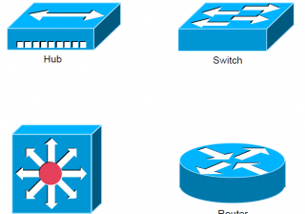



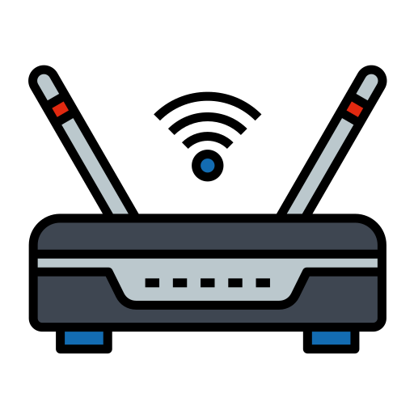
Devices & Software Used
Routers are used to connect the Kandy and Galle branches and perform inter-VLAN routing.
Layer 3 switches are used within each floor to handle VLAN segmentation and local routing.
Access Points are installed in customer service areas and boardrooms to provide secure Wi-Fi access.
Servers run services like DHCP, DNS, ERP, and IP camera storage with static IP addresses.
Cisco Packet Tracer is used to simulate, configure, and test the full network design.
Windows Server OS is installed on physical servers to host core services securely.
6
Notes:
I selected specific devices to ensure Redco’s network would be secure, scalable, and easy to manage.
Routers are used to connect both branches and also help with inter-VLAN communication across sites.
Layer 3 switches on each floor manage internal routing and VLAN separation between departments like HR, Developers, and Admin.
In customer areas and boardrooms, I installed Access Points for wireless connectivity, secured with WPA2 or WPA3 protocols.
The servers host key services like DHCP, DNS, ERP software, and IP camera storage. Each of these servers uses a static IP from the 200.100.50.0/24 range for reliable access.
To design and test everything, I used Cisco Packet Tracer, which allowed me to build the full network, configure devices, and simulate connectivity.
The servers are running Windows Server, which supports the necessary services while offering centralized control and strong security features.

Slide 9
VLAN & IP Addressing
Departments are separated using VLANs for better security and control.
Kandy uses the 200.100.10.0/24 IP range for all its internal devices.
Galle uses the 200.100.20.0/24 IP range for local devices and PCs.
The 200.100.50.0/24 subnet is reserved for servers with static IPs.
IP addresses are automatically assigned using a central DHCP server.
Smart devices and IP cameras are included in the VLAN structure and receive IP addresses via DHCP.
Inter-VLAN routing is configured on Layer 3 switches to allow communication between departments and access to shared services like ERP and DNS.
7
Notes:
This slide shows the full IP addressing and VLAN design used in Redco’s network.
Each department, like HR, Admin, Developers, and IT, is assigned a unique VLAN ID. These VLANs are consistent across both the Kandy and Galle offices.
I’ve allocated 200.100.10.0/24 for Kandy and 200.100.20.0/24 for Galle. Within each, I further divided the subnets by department using /26 blocks to avoid overlap.
All end-user devices receive their IPs dynamically via a DHCP server to simplify device configuration.
Meanwhile, core servers use static IPs in the 200.100.50.0/24 range to ensure reliability and fixed access points for services like DHCP, DNS, ERP, and IP camera storage.
This structure keeps the network efficient, secure, and scalable as Redco continues to grow.

Slide 10
VLAN Table
Department | VLAN ID | Location | IP Range
HR | 10 | Kandy, Galle | 200.100.10.0/26 & 200.100.20.0/26
Admin | 20 | Kandy, Galle | 200.100.10.64/26 & 200.100.20.64/26
Developers | 30 | Kandy, Galle | 200.100.10.128/26 & 200.100.20.128/26
IT Support | 40 | Kandy, Galle | 200.100.10.192/26 & 200.100.20.192/26
Server Room | 99 | Both Branches | 200.100.50.0/24
Kandy Office
- Floor 1: Sales, Dev, Reception
- Floor 2: HR, Admin
- Floor 3: Finance, IT, Server Room
Galle Office
- Floor 1: Dev, Reception, Cameras
- Floor 2: Admin, HR, IT, Server Room
8
Notes:
Redco’s network design uses VLANs to separate departments for better security, traffic control, and easier management.
Each department across both branches — such as HR, Admin, Developers, and IT — is assigned its own VLAN ID. For example, VLAN 10 is used for HR and VLAN 20 for Admin.
The Kandy branch uses the 200.100.10.0/24 IP range, while the Galle branch uses 200.100.20.0/24. Each subnet is large enough to support all devices in that branch.
IP addresses are automatically assigned using DHCP, which simplifies network management. However, all critical servers — like ERP, DHCP, and DNS — are assigned static IPs in the 200.100.50.0/24 subnet.
This structure ensures consistency, scalability, and smooth communication across all departments and services

Slide 11
Packet tracer diagram 1 or 2 images and explain
Add AD OU screenshot and explain, what is AD and its use as well
firewall, dmz and vpn and how they help the company development- explain

Slide 12
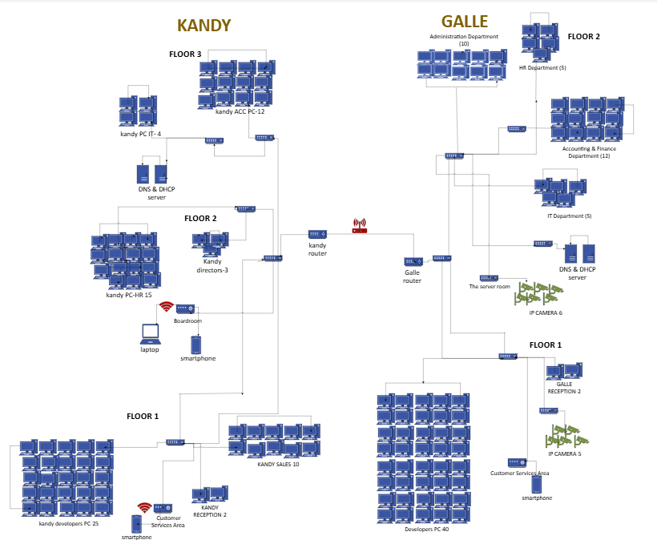
Network Blueprint of redco developments
9

Slide 13
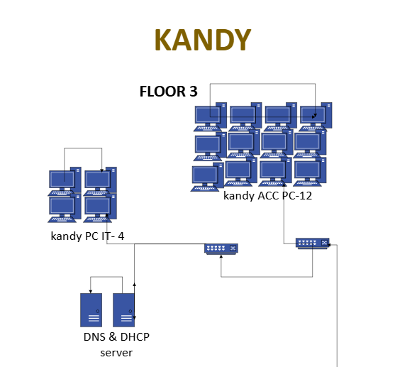
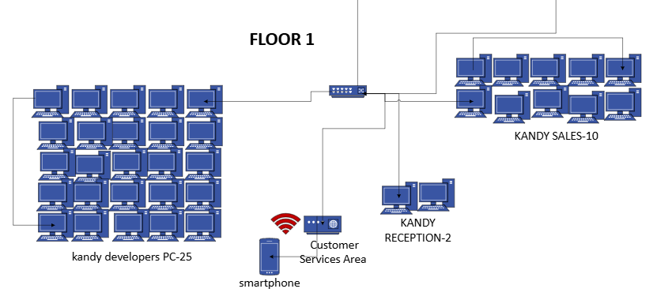
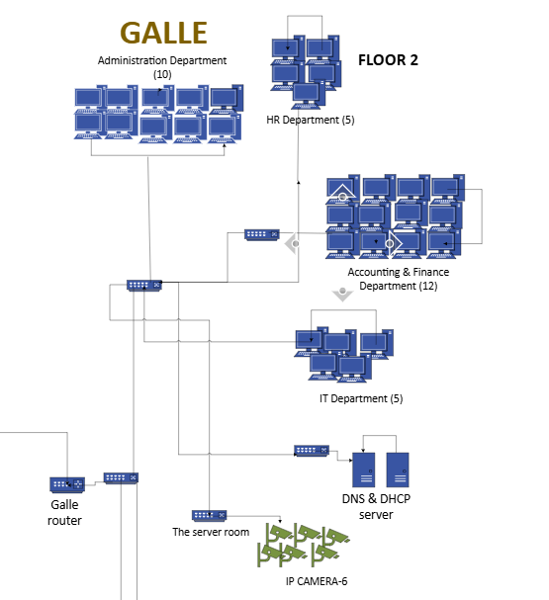
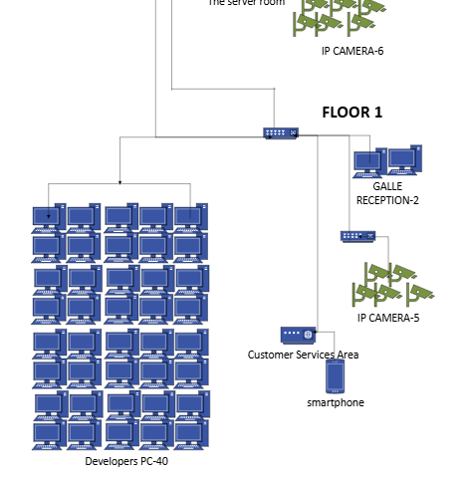
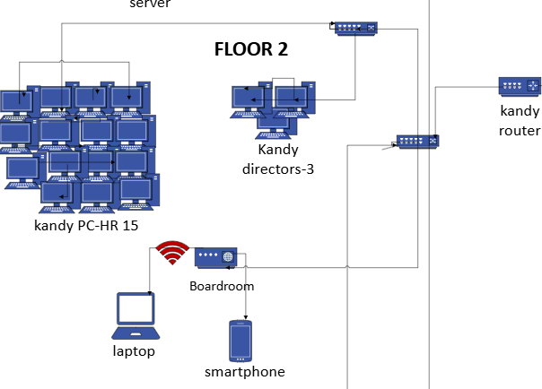
10

Slide 14
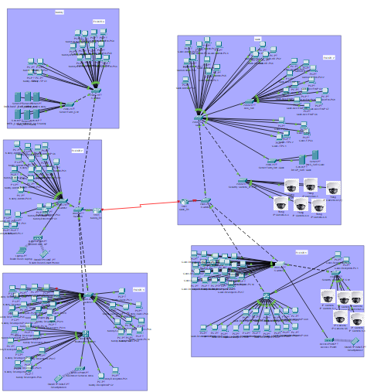
Packet Tracer Demonstration
11
Notes:
The full Redco network was built and configured using Cisco Packet Tracer.
VLANs, DHCP, inter-VLAN routing, and RIP were implemented and tested.
All devices were assigned IPs correctly and could communicate across branches.

Slide 15
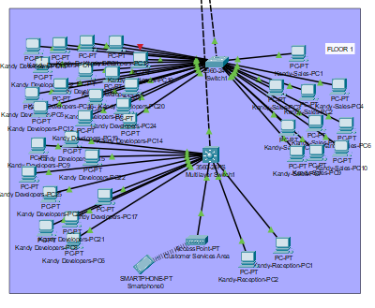
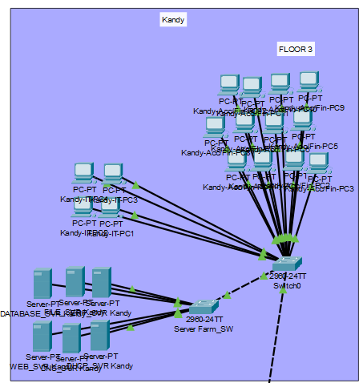
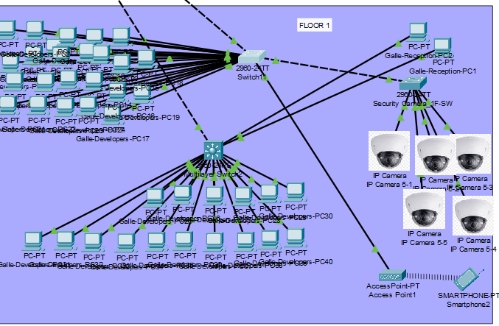
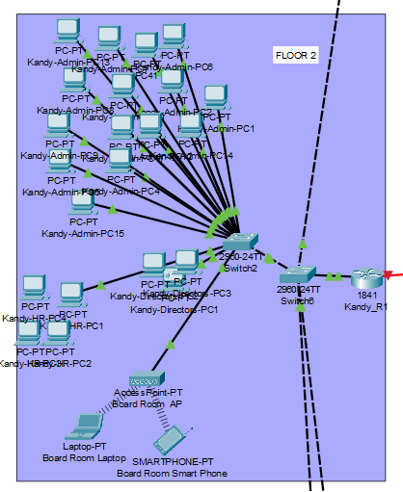
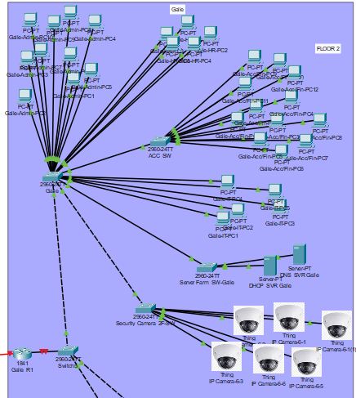
12

Slide 16
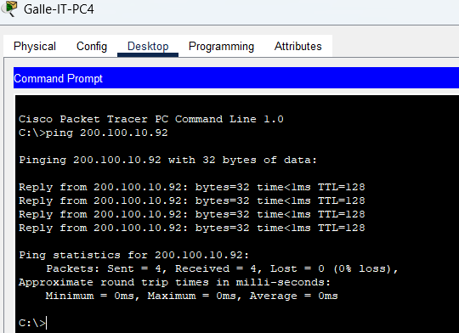
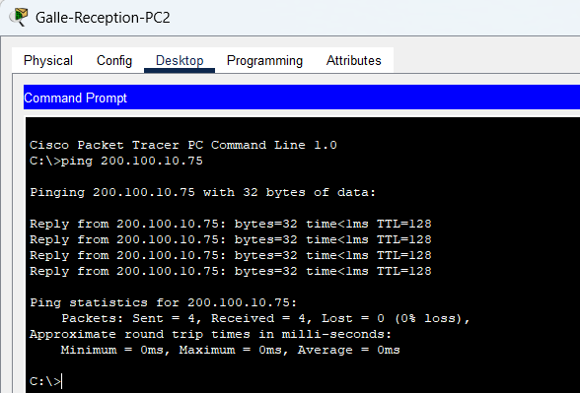
Test cases

Slide 17
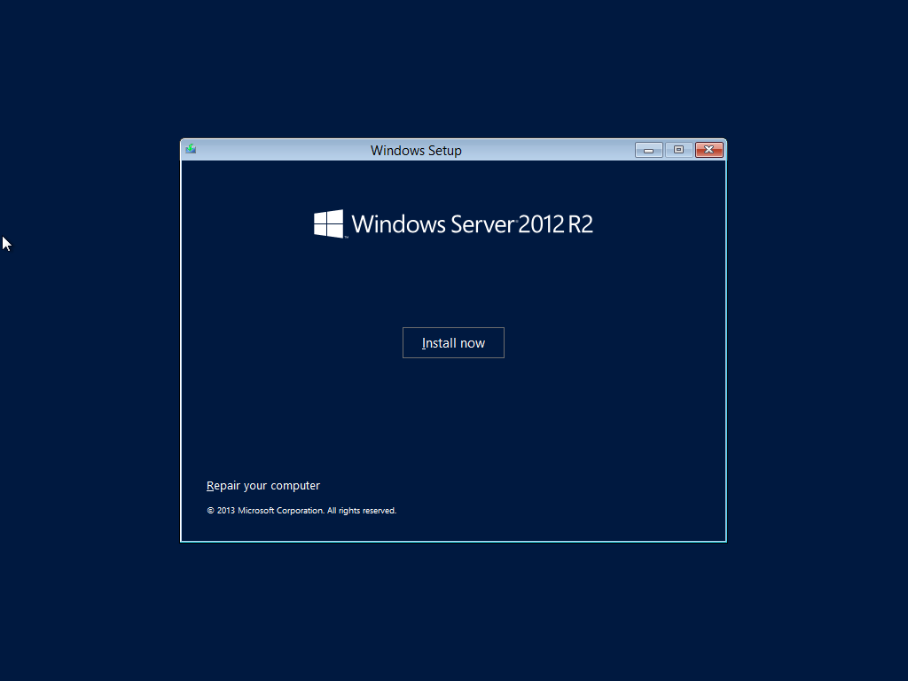
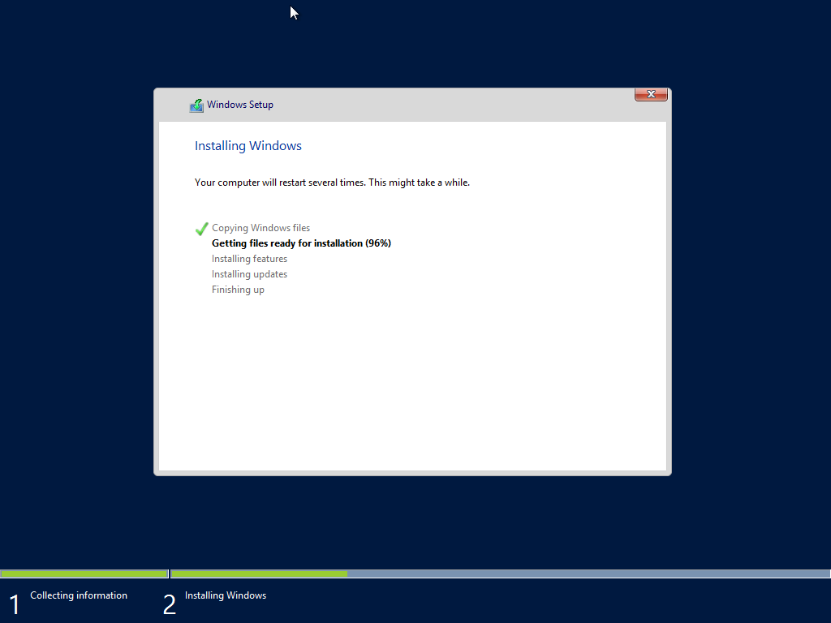

Slide 18

Network Testing
Make eye contact with your audience to create a sense of intimacy and involvement
Weave relatable stories into your presentation using narratives that make your message memorable and impactful
Encourage questions and provide thoughtful responses to enhance audience participation
Use live polls or surveys to gather audience opinions, promoting engagement and making sure the audience feel involved

Slide 19
Conclusion & Recommendations
Make eye contact with your audience to create a sense of intimacy and involvement
Weave relatable stories into your presentation using narratives that make your message memorable and impactful
Encourage questions and provide thoughtful responses to enhance audience participation
Use live polls or surveys to gather audience opinions, promoting engagement and making sure the audience feel involved

Slide 20
OVERCOMING NERVOUSNESS
CONFIDENCE-BUILDING STRATEGIES

Slide 21

THE POWER OF COMMUNICATION

Slide 22
SELECTING VISUAL AIDS
ENHANCING YOUR PRESENTATION

Slide 23
Effective delivery techniques
This is a powerful tool in public speaking. It involves varying pitch, tone, and volume to convey emotion, emphasize points, and maintain interest:
Pitch variation
Tone inflection
Volume control
Effective body language enhances your message, making it more impactful and memorable:
Meaningful eye contact
Purposeful gestures
Maintain good posture
Control your expressions

Slide 24
NAVIGATING Q&A SESSIONS
Know your material in advance
Anticipate common questions
Rehearse your responses
Maintaining composure during the Q&A session is essential for projecting confidence and authority. Consider the following tips for staying composed:
Stay calm
Actively listen
Pause and reflect
Maintain eye contact

Slide 25

SPEAKING IMPACT
Your ability to communicate effectively will leave a lasting impact on your audience
Effectively communicating involves not only delivering a message but also resonating with the experiences, values, and emotions of those listening

Slide 26
Dynamic delivery
Learn to infuse energy into your delivery to leave a lasting impression
One of the goals of effective communication is to motivate your audience
METRIC | MEASUREMENT | TARGET | ACTUAL
Audience attendance | # of attendees | 150 | 120
Engagement duration | Minutes | 60 | 75
Q&A interaction | # of questions | 10 | 15
Positive feedback | Percentage (%) | 90 | 95
Rate of information retention | Percentage (%) | 80 | 85

Slide 27
FINAL TIPS & TAKEAWAYS
Consistent rehearsal
Strengthen your familiarity
Refine delivery style
Pacing, tone, and emphasis
Timing and transitions
Aim for seamless, professional delivery
Practice audience
Enlist colleagues to listen & provide feedback
Seek feedback
Reflect on performance
Explore new techniques
Set personal goals
Iterate and adapt

Slide 28
SPEAKING ENGAGEMENT METRICS
IMPACT FACTOR | MEASUREMENT | TARGET | ACHIEVED
Audience interaction | Percentage (%) | 85 | 88
Knowledge retention | Percentage (%) | 75 | 80
Post-presentation surveys | Average rating | 4.2 | 4.5
Referral rate | Percentage (%) | 10 | 12
Collaboration opportunities | # of opportunities | 8 | 10

Slide 29

Thank you for your time and attention!
Questions and Answers

